Slide 1
Decorator pattern

Slide 2

You are going to open a star fucks coffee chain

Slide 3
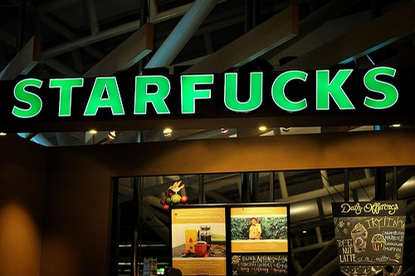


Slide 4
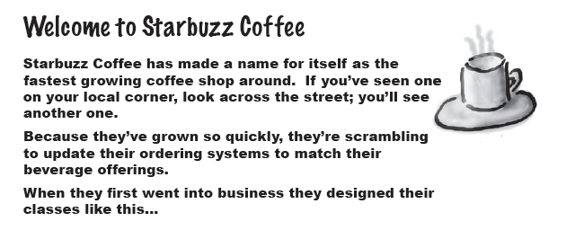
An example

Slide 5
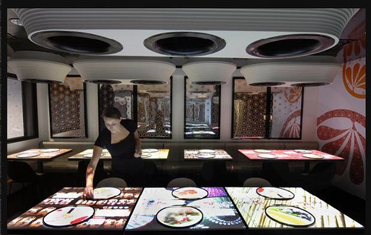
You are hired to implement an table order system

Slide 6
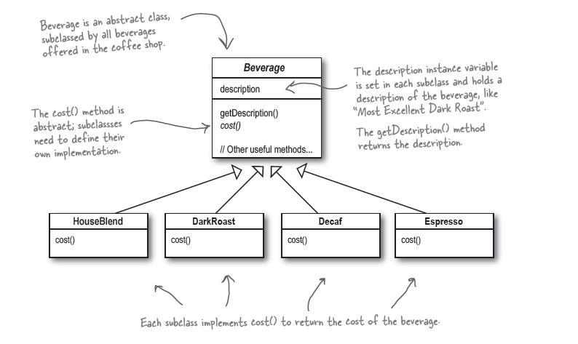
Your first idea of implementation

Slide 7
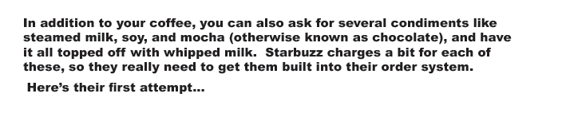
In reality

Slide 8
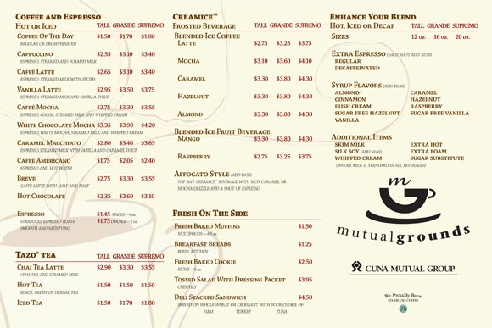

Slide 9
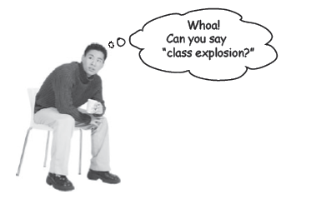
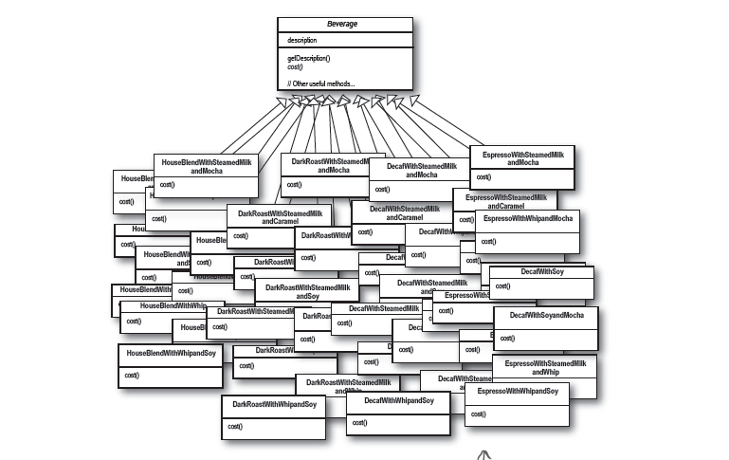
Now a beverage can be mixed from different condiment to form a new beverage

Slide 10
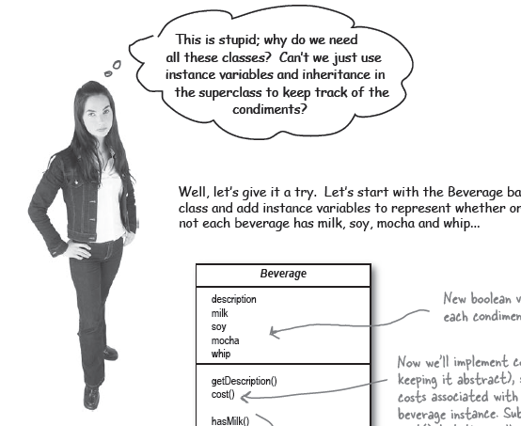
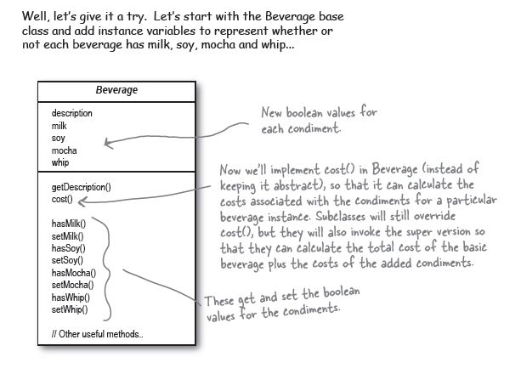

Slide 11
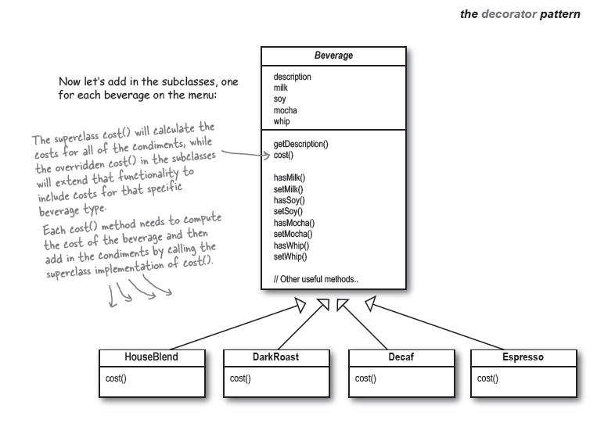

Slide 12

Now, your turns. It is a good solution?

Slide 13
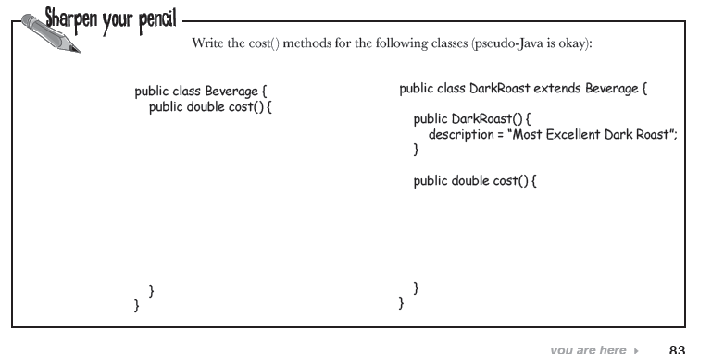
Try several minutes to complete

Slide 14
Some Hints
Call parent class’s method in an overridden method
class base {
virtual void foo() { ….}
}
class son_of_base: base {
virtual void foo() {
base::foo(); // C++
super.foo(); // java
…. // do something else for your own
}

Slide 15
What can you criticize about this inheritance architecture?
Write down your notes to see if you are right

Slide 16
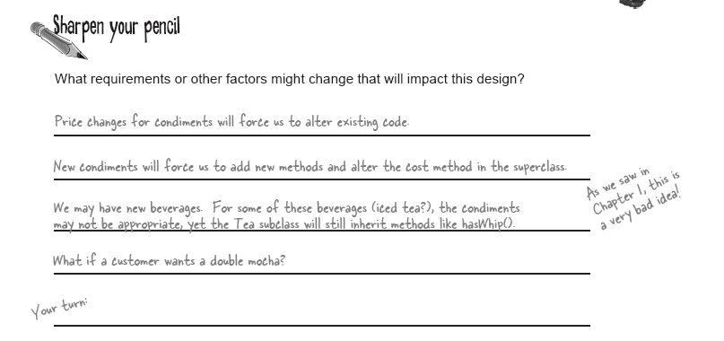

Slide 17
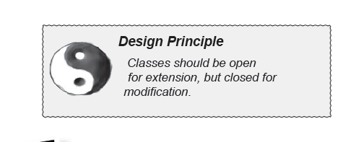

Slide 18

Remember the old time

Slide 19

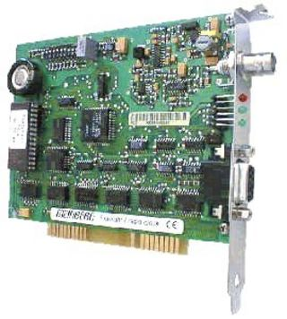
You open case to install the interface card

Slide 20
Some history about PC extension evolution
In the past, an extension of your PC hardware means open your PC case with screw driver – which violate the design principle close for modification
The design of open ISA, PCI, ATA… bus did fulfill the principle of open for extension.
PC hardware has gone a long way to make extension easily
USB come

Slide 21
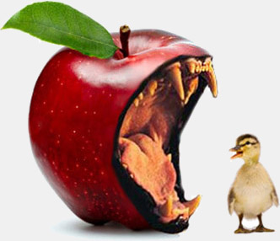

Evil Apple ?

Slide 22
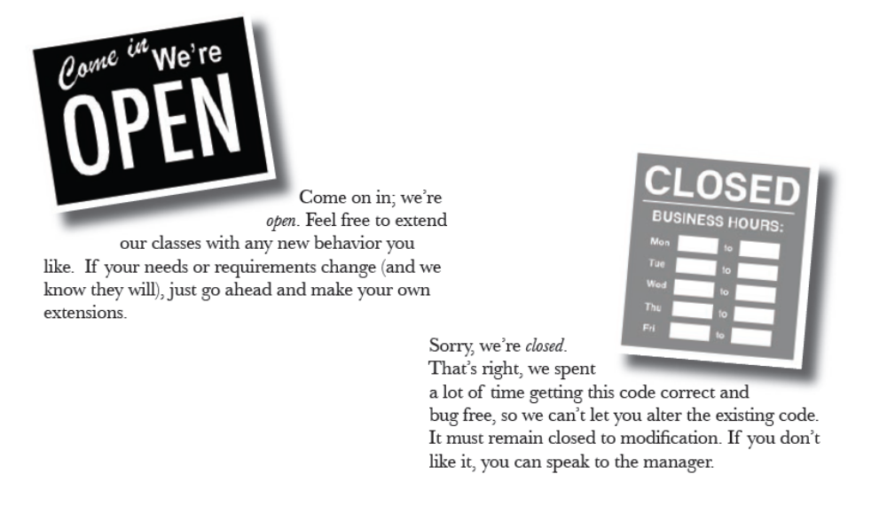

Slide 23
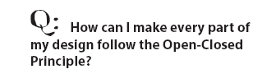
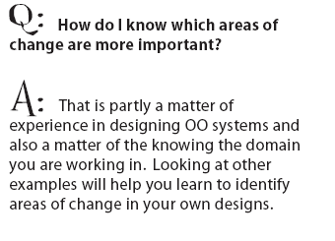
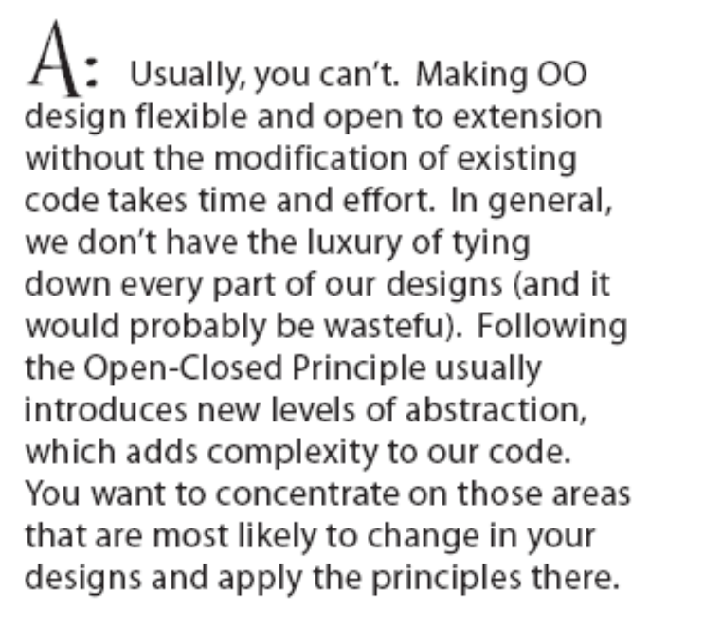

Slide 24
Decorator Pattern
The problems of two previous designs
  we get class explosions, rigid designs,
  or we add functionality to the base class that isn’t appropriate for some of the subclasses.

Slide 25
Revisit the problem again
If a customer wants a Dark Roast with Mocha and Whip
  Take a DarkRoast object
  Decorate it with a Mocha object
  Decorate it with a Whip object
  Call the cost() method and rely on
  delegation to add on the condiment costs

Slide 26
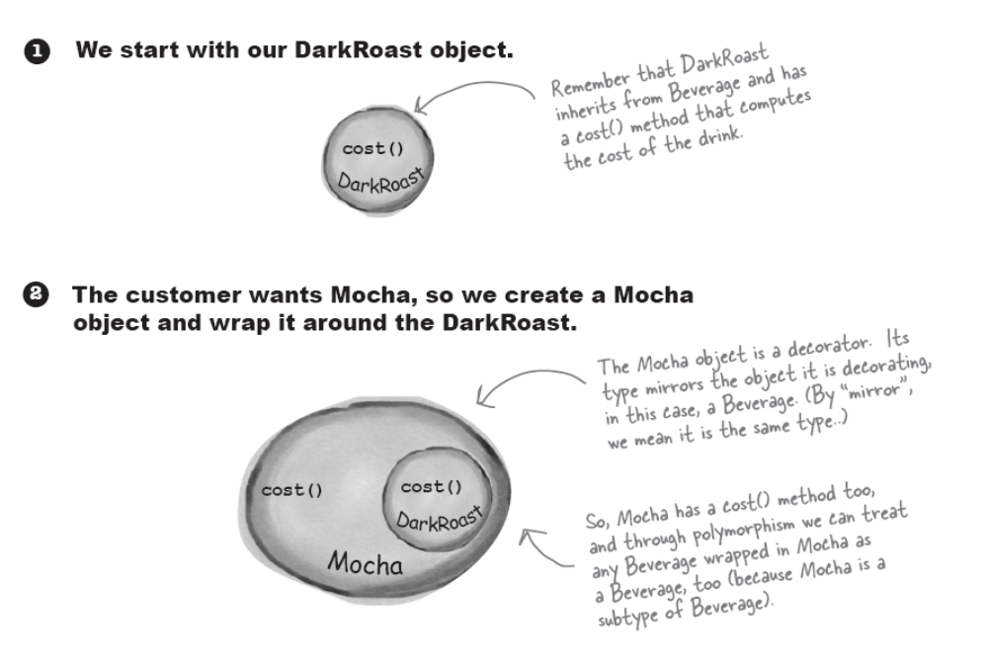
Constructing a drink order with Decorators

Slide 27
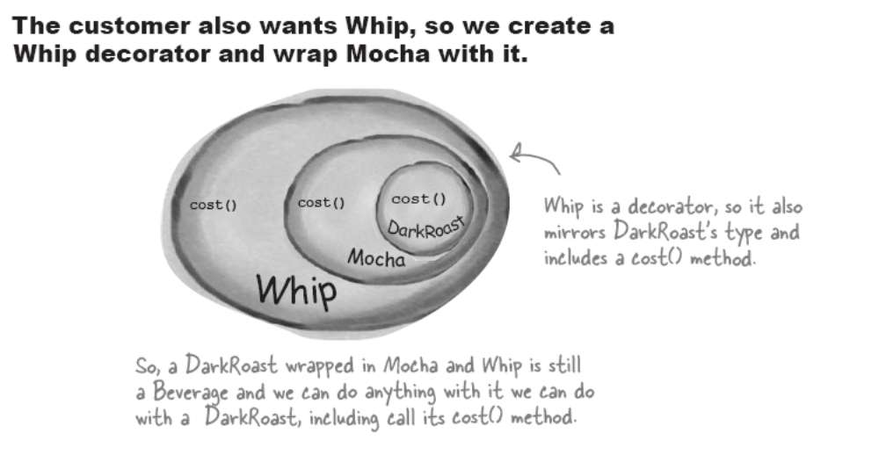

Slide 28
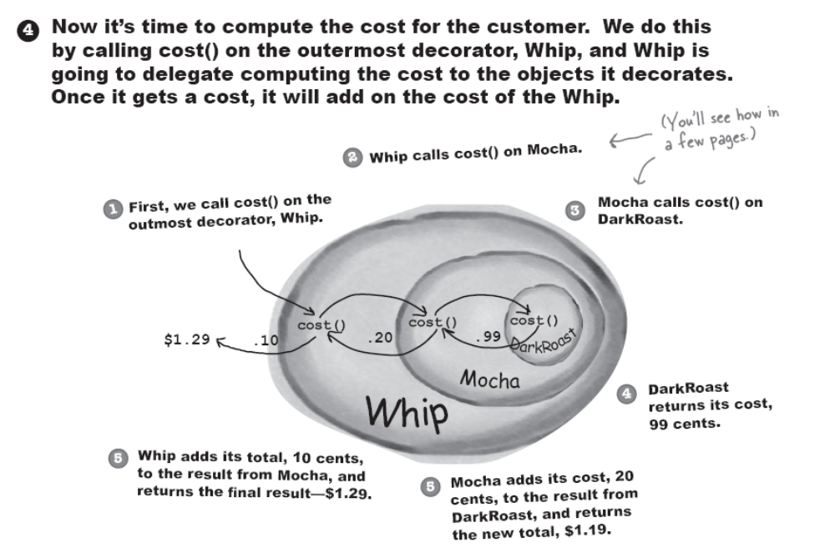

Slide 29
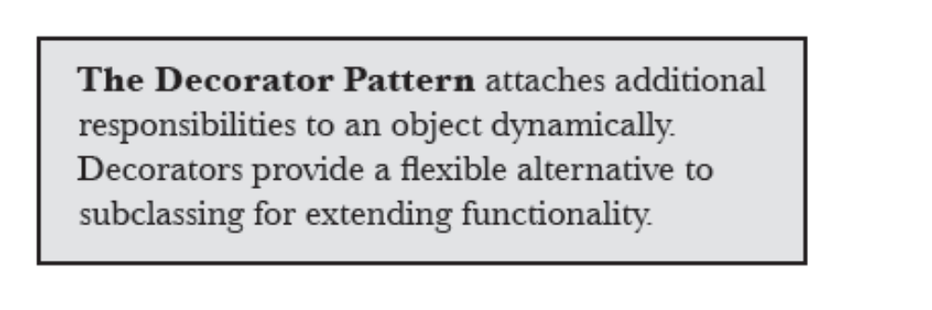

Slide 30
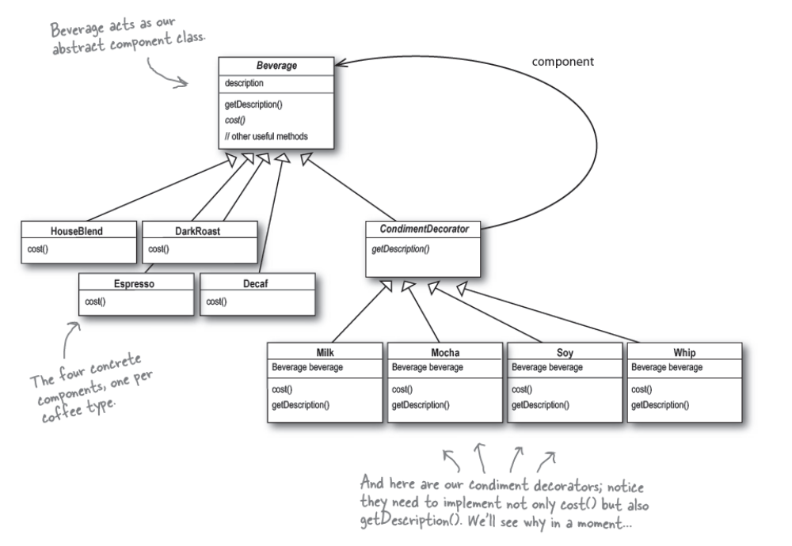
The decorator pattern for Starbuzz beverages

Slide 31
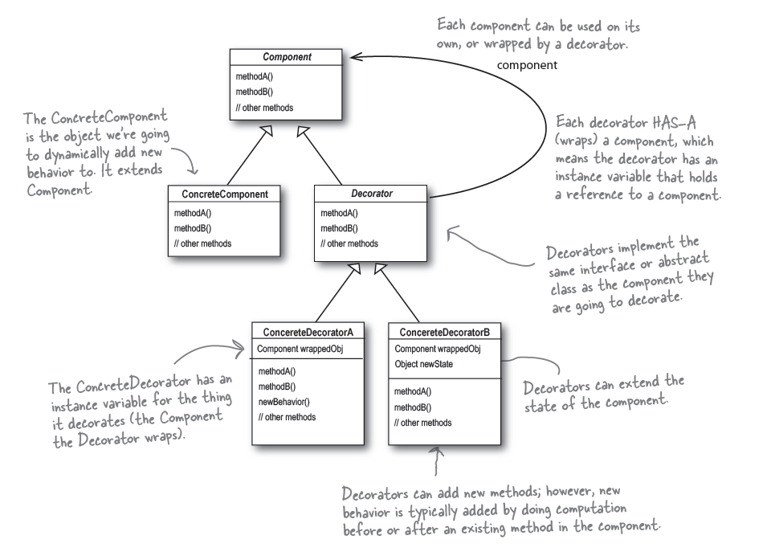
Decorator Pattern defined

Slide 32
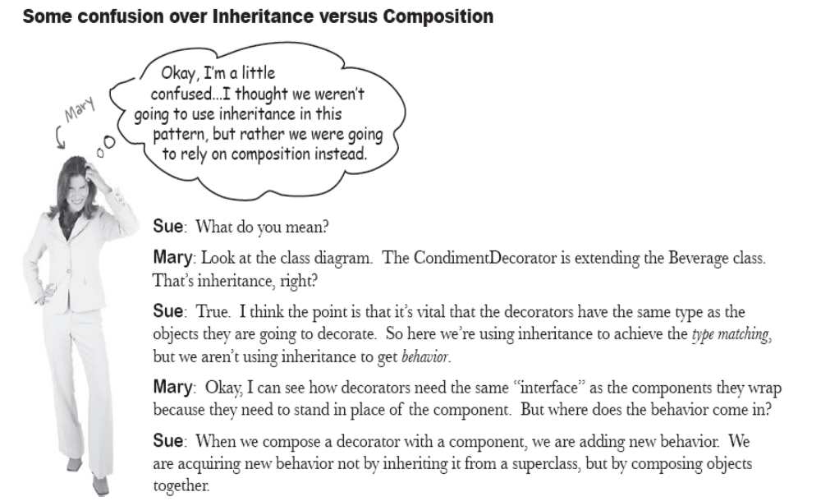

Slide 33
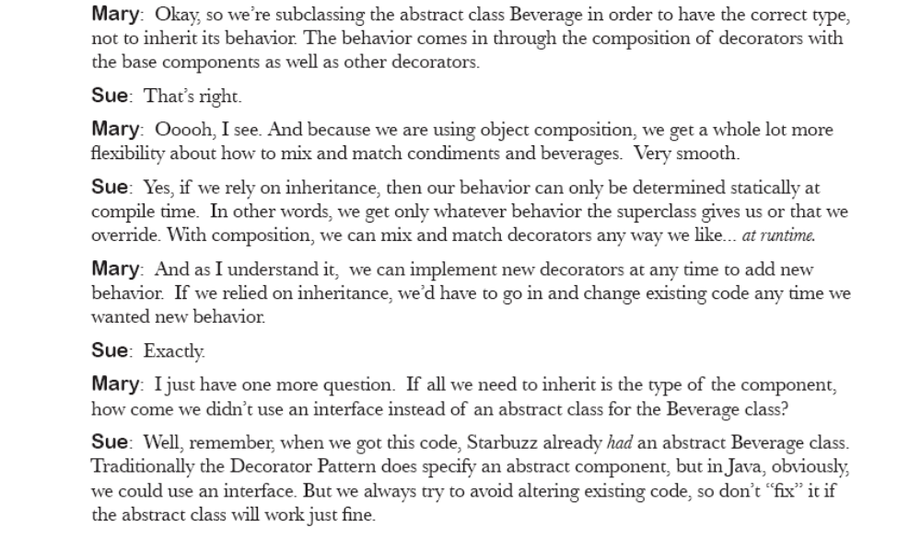

Slide 34
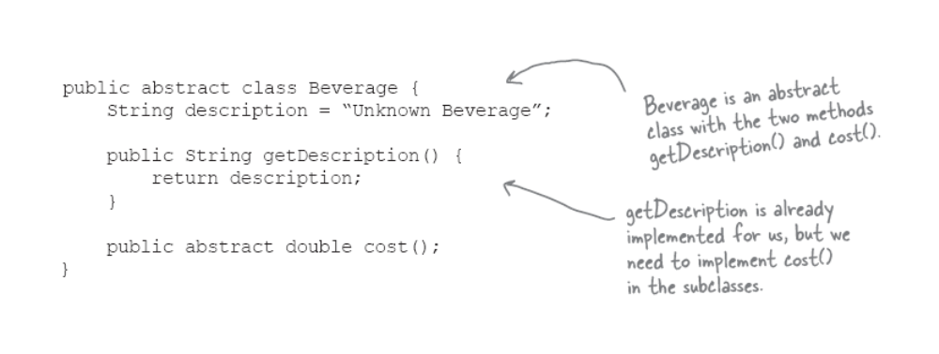
Let’s see the code

Slide 35
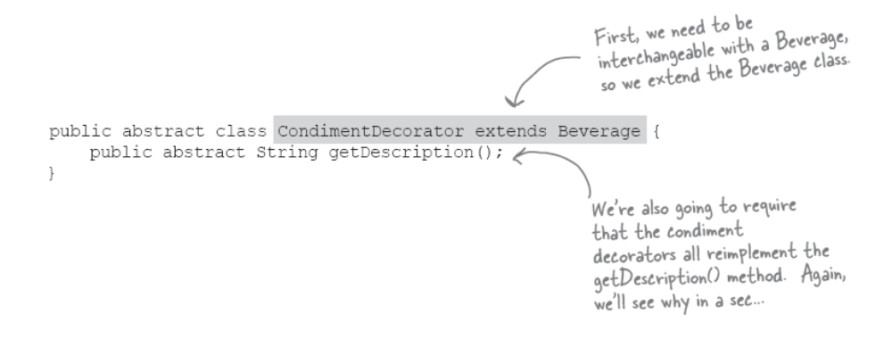
The abstract class of condiments

Slide 36
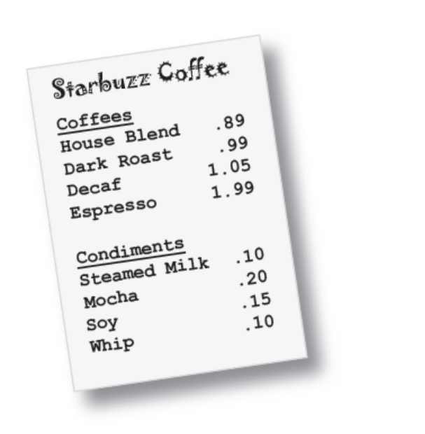
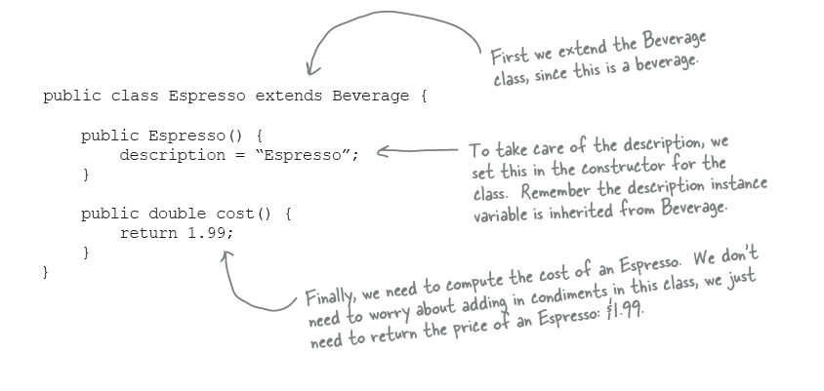
Concrete Base Classes of Beverages

Slide 37
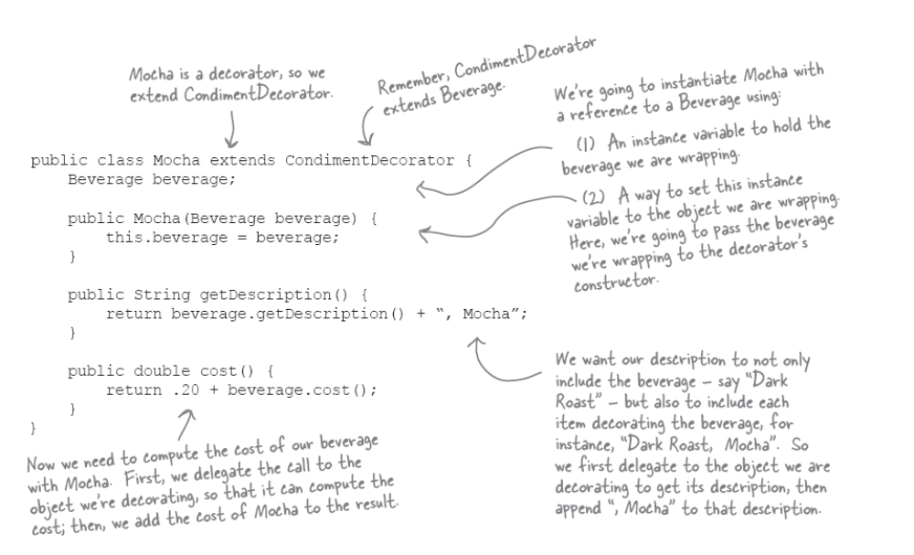
A concrete Condiment class
When Mocha price changed, we only need to change this class

Slide 38
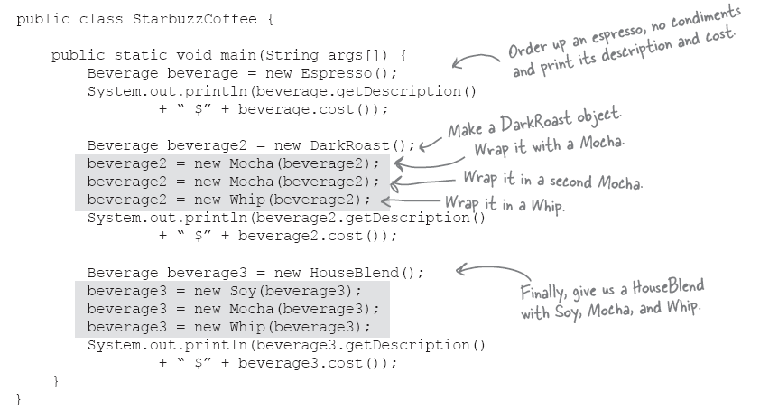
Constructing new beverages from decorator classes dynamically

Slide 39
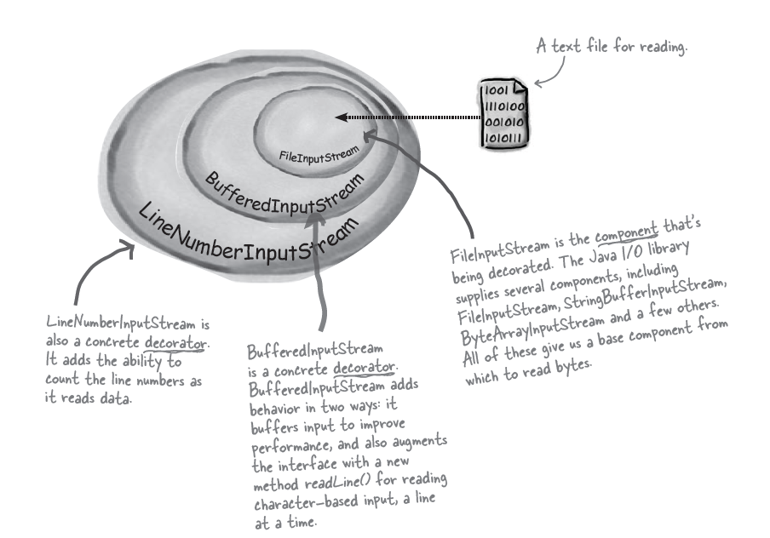
Real world decorator – Java I/O
Java I/O

Slide 40
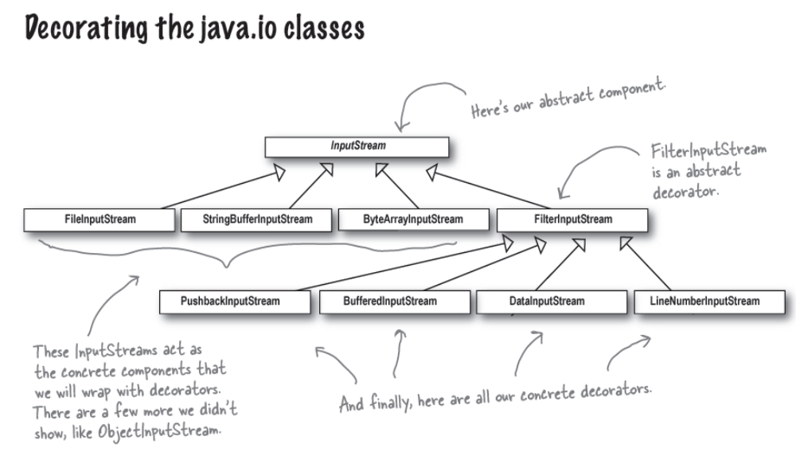

Slide 41
Comments
You can see that this isn’t so different from the Starbuzz design. You should now be in a good position to look over the java.io API docs and compose decorator s on the various input streams.
You’ll see that the output streams have the same design. And you’ve probably already found that the reader/Writer streams (for character-based data) closely mirror the design of the streams classes (with a few differences and inconsistencies, but close enough to figure out what’s going on).

Slide 42
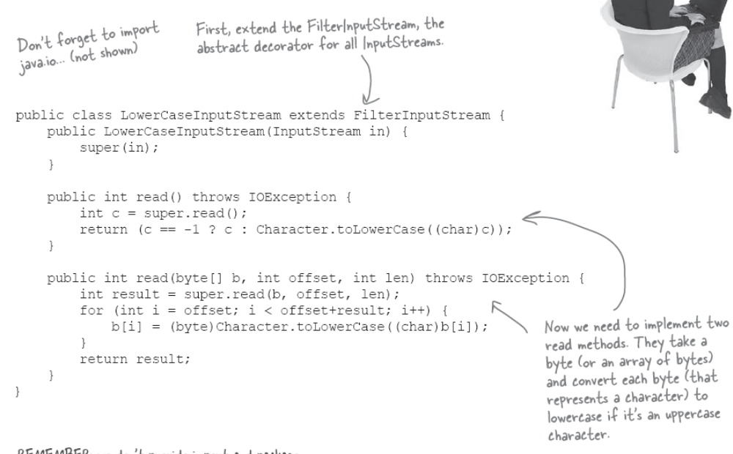
Let’s write a new decorator

Slide 43
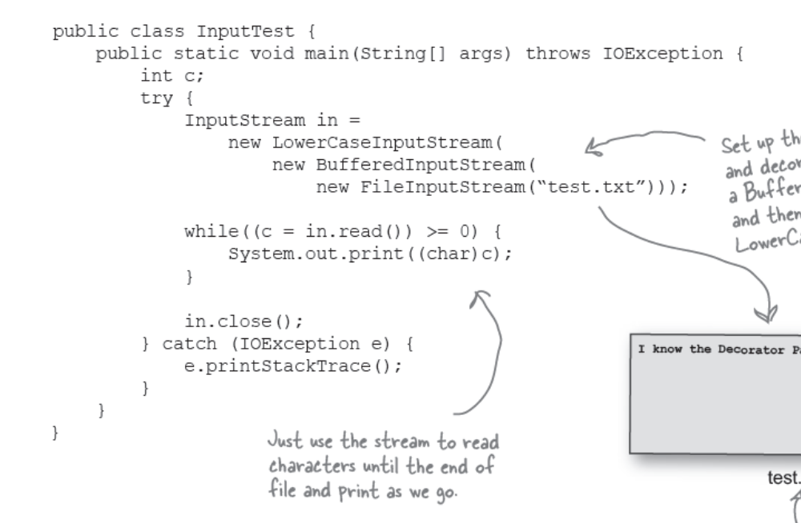
Test out your new Java I/O decorator

Slide 44
Dark Side
You can usually insert decorators transparently and the client never has to know it’s dealing with a decorator
However, if you write some code is dependent on specific types -> Bad things happen
Java library is notorious to be used badly by people who do not know decorator pattern

Slide 45

The right way
Beverage beverage2 = new DarkRoast();
beverage2 = new Mocha(beverage2);
beverage2 = new Mocha(beverage2);
beverage2 = new Whip(beverage2);
System.out.println(beverage2.getDescription()
+ “ $” + beverage2.cost());
Beverage beverage2 = new DarkRoast();
beverage2 = new Mocha(beverage2);
beverage2 = new Mocha(beverage2);
Whip beverage3 = new Whip(beverage2);
System.out.println(beverage3.getDescription()
+ “ $” + beverage2.cost());
The poor way

Slide 46
